Slide 1

Social media text analysis for psycho-emotinal expressions of sentiment, emotions, intent, manipulation and cognitive distortions in social media for Chinese

Slide 2







Problem & Vision
Data & Features
Architecture & Taxonomy
Results & Metrics

Slide 3
From Sentiment to Psyche: The Gap
Traditional tools fail to uncover the psychological harm and cognitive distortions hidden in Chinese social media, leaving clinicians and researchers in the dark.
Opaque Models
Linguistic Blindness
Black-box APIs hide their reasoning, making their psycho-emotional assessments unverifiable and untrustworthy.
Invisible Risks
Unique Chinese particles, compound verbs, and negation patterns are ignored, leading to culturally inaccurate analysis.
Cognitive distortions that signal mental health risks remain undetected, preventing early intervention.

Slide 4

We propose a rule-based engine that exposes every scoring step to human scrutiny, ensuring every decision is traceable and explainable.
77 Explainable Features: A compact dictionary of n-grams with human-readable justifications.
Cultural Fidelity: Embedded Chinese-specific linguistic patterns for accurate analysis.

Slide 5
Modular Pipeline From Post to Insight
A four-stage, pluggable architecture ensuring transparency and accountability at every step.
1
2
3
4
Data Loading
Preprocessing
Feature Engineering
Analysis & Viz
Scrapes APIs while respecting rate limits and anonymizing users.
Normalizes text and segments it with a domain-adapted dictionary.
Applies the 77 hand-curated n-gram features for scoring.
Generates transparent logs, CSV summaries, and risk flags.

Slide 6
Ten Cognitive Distortions Defined
Mental Filtering: Selective negative attention, e.g., "只看到坏处".
Personalization: Excessive self-blame, e.g., "都是我害的".
Overgeneralization: Broad negative conclusions, e.g., "总是", "永远".
Catastrophizing: Expecting the worst, e.g., "完蛋了".
Mind Reading: Assuming others' thoughts, e.g., "他们肯定嘲笑我".
Labeling: Global negative evaluation, e.g., "废物".
Emotional Reasoning: Feelings as facts, e.g., "我感到绝望所以没希望".
Should Statements: Rigid demands, e.g., "我应该完美".
Magnification: Exaggerating negatives.
Minimization: Downplaying positives.

Slide 7

863 Real Posts, Four Platforms
A double-coded corpus (κ = 0.81) providing a robust foundation for psycho-emotional analysis.
Weibo: 700 texts (81.1%)
Douyin: 75 captions
Xiaohongshu: 60 notes
557
306
Zhihu: 28 answers
Negative Posts
Positive Posts

Slide 8
Mental Filtering Patterns
77
("只看到",) → weight: 0.9, explanation: "Selective attention to negative".
Personalization Patterns
("都是", "我的错") → weight: 1.0, explanation: "Complete self-attribution".
Transparent N-Gram Signals
Catastrophizing Patterns
("万一", "失败") → weight: 0.85, explanation: "Forecasting disaster".
A curated dictionary where every feature is explainable and editable.

Slide 9
Detection Rates Per Distortion Class
Posts with ≥1 Distortion
Manipulation Intent
48.2%
51.4%
Unclassified Distortions
47.7%
Positive Sentiment
35.2%
Labeling Distortion
12.5%
High-Risk Posts (≥2)
Personalization
0%
35.9%

Slide 10

Correlation Clusters
Pearson analysis reveals strong co-occurrence patterns, clustering into two meta-factors.
Emotional-Distortion Bundle
Catastrophizing & Labeling: r = 0.975
Manipulative-Impression Bundle
Manipulation & Positive Sentiment: r = 0.793

Slide 11
Platform-Specific Analysis
Weibo (700 texts)
Mental Filtering (60 texts)
Personalization (75 texts)
Highest manipulation scores, driven by influencer marketing and polarized threads.
Targeted dataset validates the effectiveness of specialized n-grams.
Exposes a critical blind spot in detecting self-blame language.
Manipulation Score: 0.457
Labeling Score: 0.243
Detection Rate: 22.5%
Detection Rate: ~0%

Slide 12
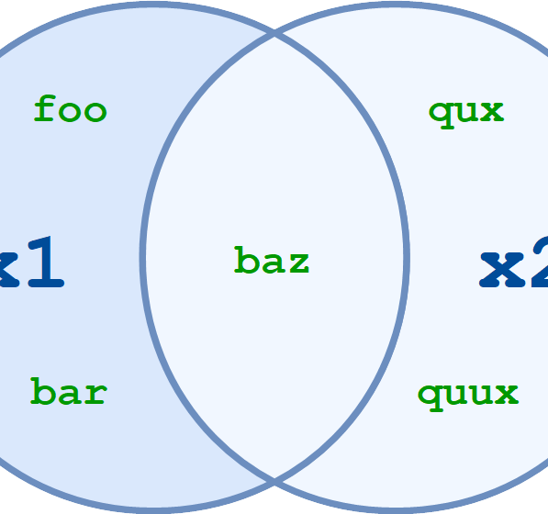
Visual Analytics Suite
Auto-generated deliverables provide actionable insights for clinicians and moderators.
Feature Distributions
Correlation Heatmaps
Histograms of distortion prevalence.
Cluster analysis of co-occurring features.
Platform Comparisons
Risk Flags
Cross-platform score analysis.
Prioritized lists for manual review.

Slide 13



